Slide 1
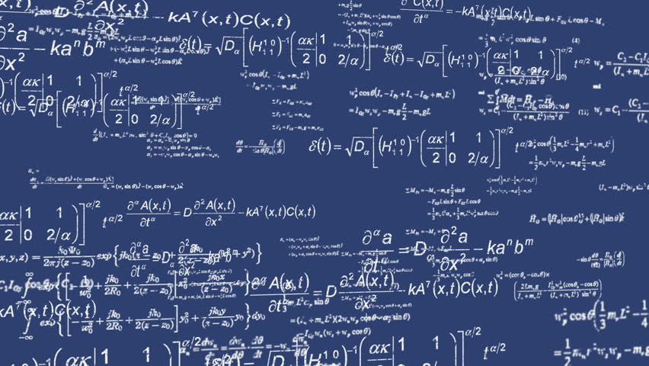

Computation of
Mathematical Equations
Using Gestures
By
Aakash Shah
Adesh Shah
Parth Shah
Dhruv Vora

Slide 2
TABLE OF CONTENT
1
Introduction
5
Design
Includes description, problem formulation, motivation, solution and scope of project
Includes the architectural diagram and the user interface design
2
6
Review of Literature
Conclusion
Includes summary of knowledge gained about existing technologies and what has to be done by us
Concluding what we have presented in the project
3
7
System Analysis
References
Includes different types of requirements and use case of the system
List of references that we have reffered to
4
Analysis Modeling
Includes different diagrams that explain the flow and functionalities of the system

Slide 3
Chapter 1
Introduction

Slide 4
INTRODUCTION
Mathematics is an integral part of the education system. There are many aspects of mathematics which are complex and dreaded by students because of the complexity of solving those problems and equations.
There are many online tools available that help students solve these equations to help them understand the concepts and aid them for future problem solving. But inputting the equations to these online tools and websites can become very tedious in case of big, complex problems.
Thus we aim to develop a tool that will aid the students in this matter. The students can simply draw the entire problem in air and our system will recognize the numbers and operations based on the gesture and provide the answer.

Slide 5
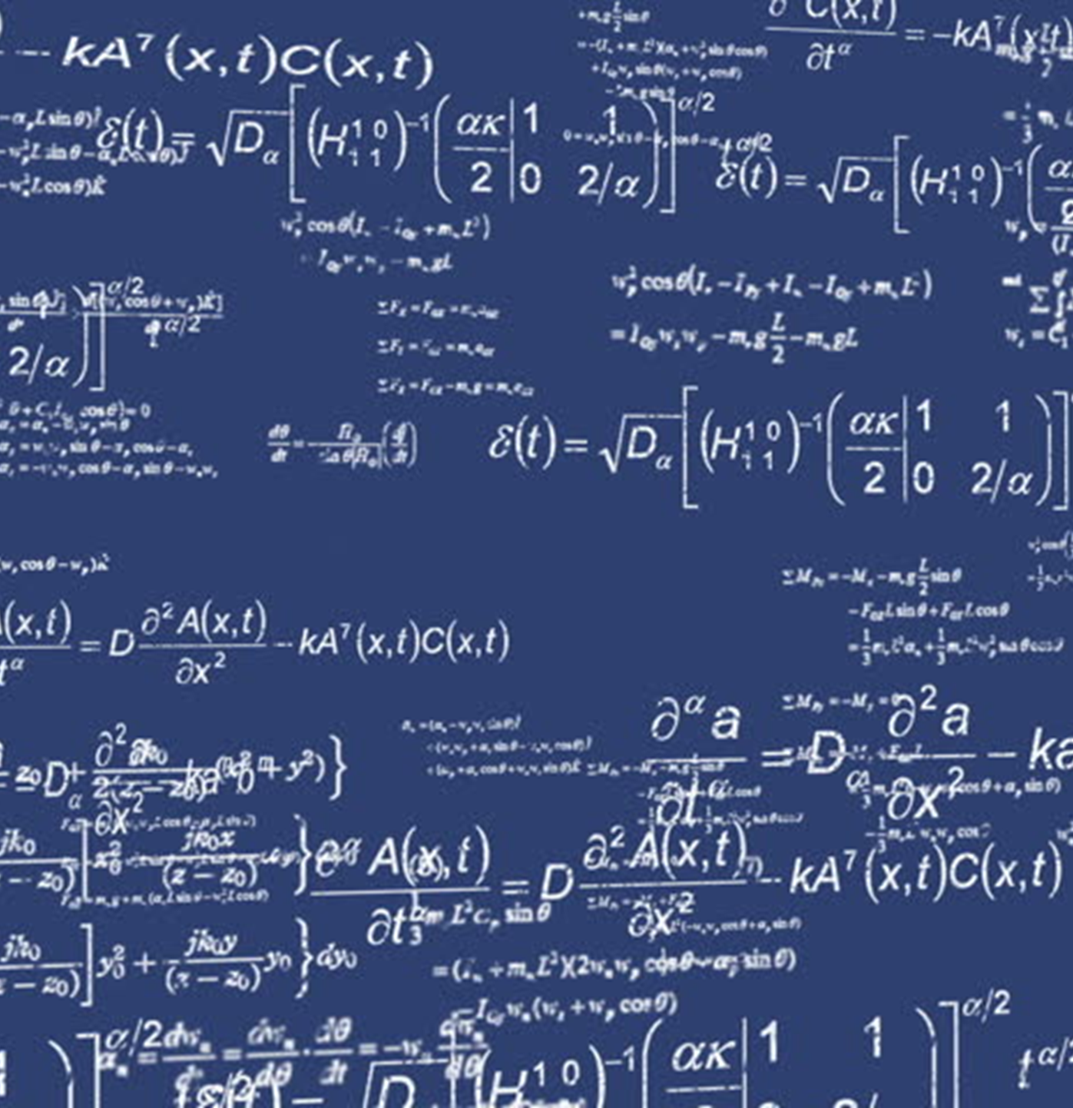
PROBLEM
FORMUALTION

Slide 6
Scope of the Project

Slide 7
PROPOSED SOLUTION
Hand Movement Tracking
Classification of letters, digits and operators
Computation of Equation
User will give the input from the web camera. After differentiating, only the hand will be tracked.
Using machine learning, convoluted neural network and a dataset, input will be broken down and appropriately classified.
Based on the equation and type of operation to be performed, the system will solve the equation.
Tracking
Recording
Classification
Formulation
Computation
Output
Innovation
Improve
Success
Recording the Input Stream
Formulation of Mathematical Equation
Output Presentation
Input given by the user with his hand will be recorded.
Digits, letters and operators will be combined together to form a logical mathematical equation.
The result of computation will be displayed to the user.

Slide 8
Chapter 2
Review of Literature

Slide 9
Gesture Recognition Techniques in Handwriting Recognition Application, proposes three methods to recognize different hand gestures such as backspace, space, enter, tab that required during handwriting recognition applications.
The first method, i.e. the pixel-matching method the similarity between the input and stored gesture template is calculated to classify the gesture.
Type 1 of the Discriminant-function method is the prototype method in which features of few typical samples are extracted and set as templates.
This method is good for user defined gestures while the training method (Type 2) is good for predefined gestures where enough training samples are available.

Slide 10
The second paper that we reviewed proposed a neural network based approach, maximum cosine similarity and fast nearest neighbor techniques as the best method in terms of accuracy for classification of digits and letters.
This method takes the advantage of high recognition accuracy and computational advantages of isolated recognition, gesture recognition, and gesture spotting on continuous streams of data.
Notes:
It divides the entire process of gesture recognition in various steps.
It starts with hand detection, followed by gesture representation from the detected hand, recognition of the gestures, verification for detecting random or out of vocabulary gestures which could reduce the effectiveness, and then spotting the gestures in the continuous signal streams.

Slide 11
The third paper, Hand Gesture and Character Recognition Based on Kinect Sensor, proposes the use of using the Kinect sensor to obtain image data and depth data along with estimating the joint position of the body.
The Kinect sensor returns an accuracy of 96.6% which is even better than multiple camera feed input.
This accuracy is for almost all the letters except for certain character like 4 and 9, D and P due to similarity in the air gesture inputs for the same.
Kinect sensor is efficient and results in a huge accuracy but people are unaware of the capabilities of the Kinect sensor.

Slide 12
Chapter 3
System Analysis

Slide 13
FUNCTIONAL
REQUIREMENTS

Slide 14
NON-FUNCTIONAL
REQUIREMENTS

Slide 15
Chapter 4
Analysis Modeling

Slide 16
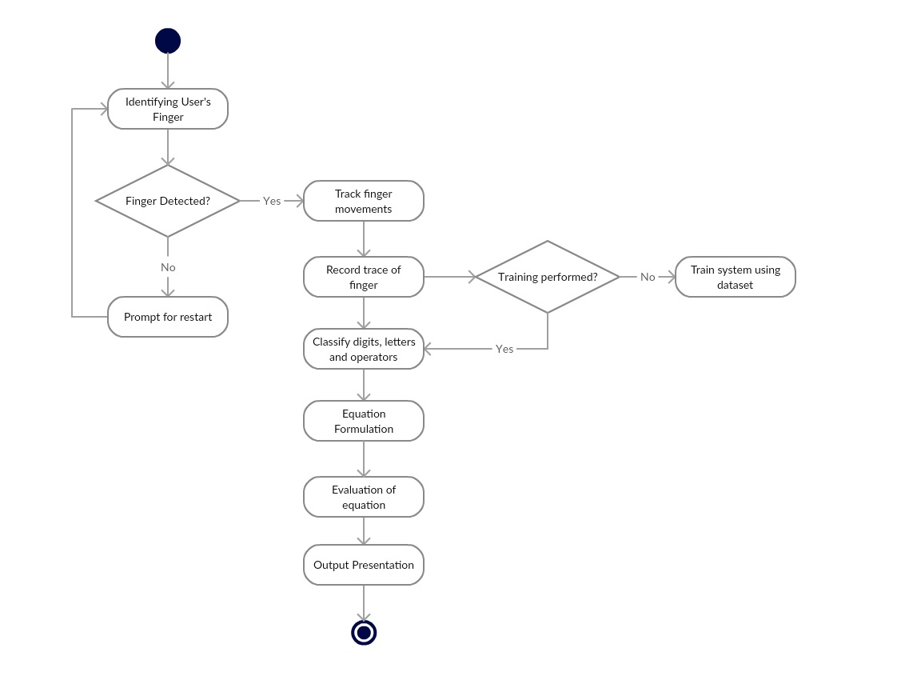
ACTIVITY
DIAGRAM

Slide 17
The flow of actions is as follows:
1. The system will identify the visual input (the green pointer) and if detected properly, would proceed further.
2. Then the movements of the visual marker would be tracked.
3. After recording the trace, if training has already been performed, we would proceed to the next step, else training would be performed.
4. The digits, letters and operators will be classified and the equation will be constructed. The equation will be evaluated and the result will be displayed.

Slide 18
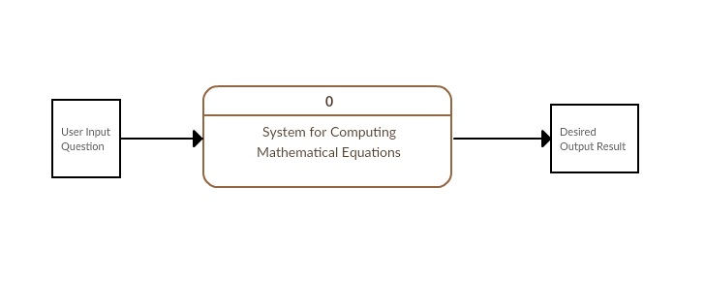
DFD
LEVEL 0

Slide 19
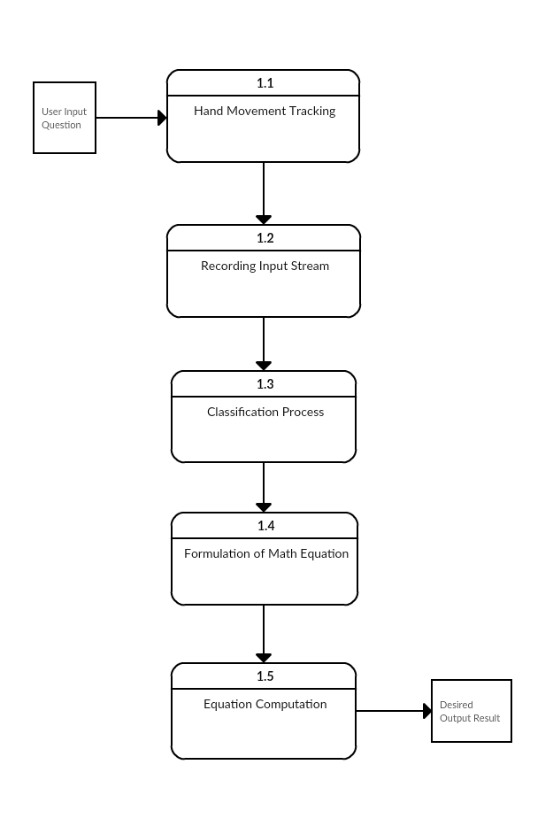
DFD
LEVEL 1

Slide 20
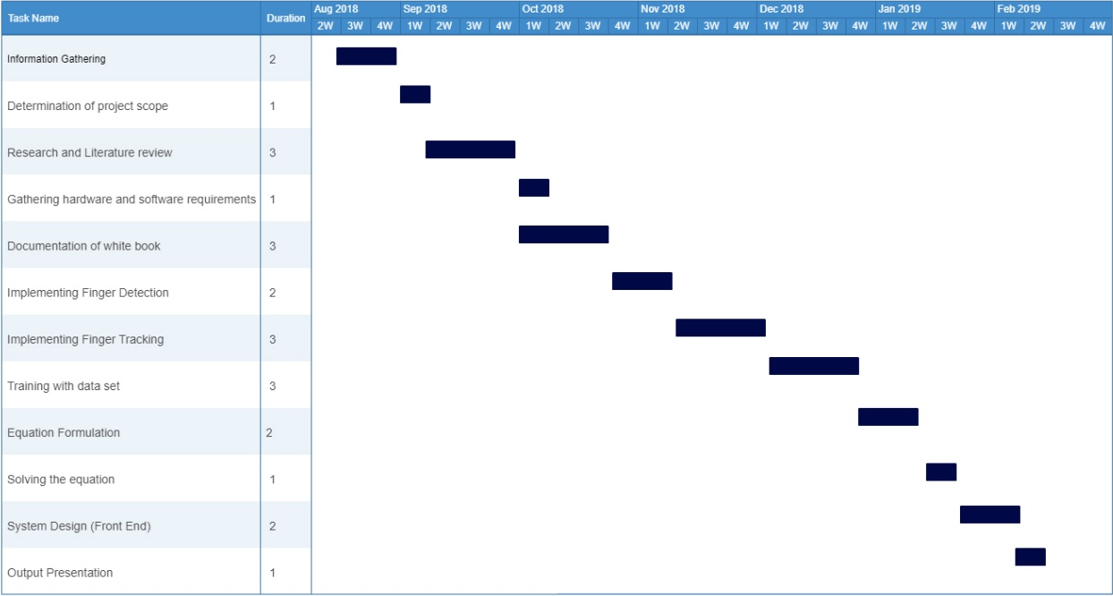
TIMELINE

Slide 21
Chapter 5
Design

Slide 22
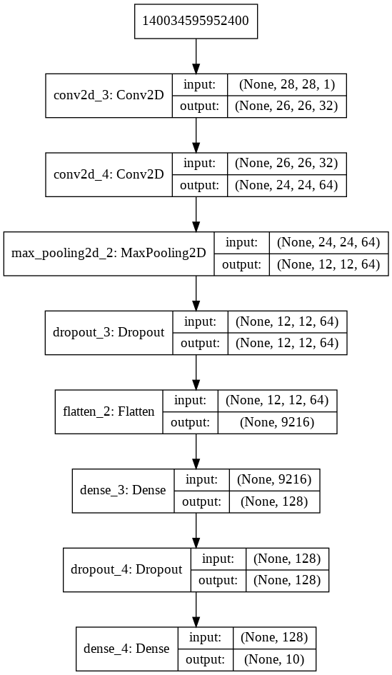
CNN MODEL

Slide 23
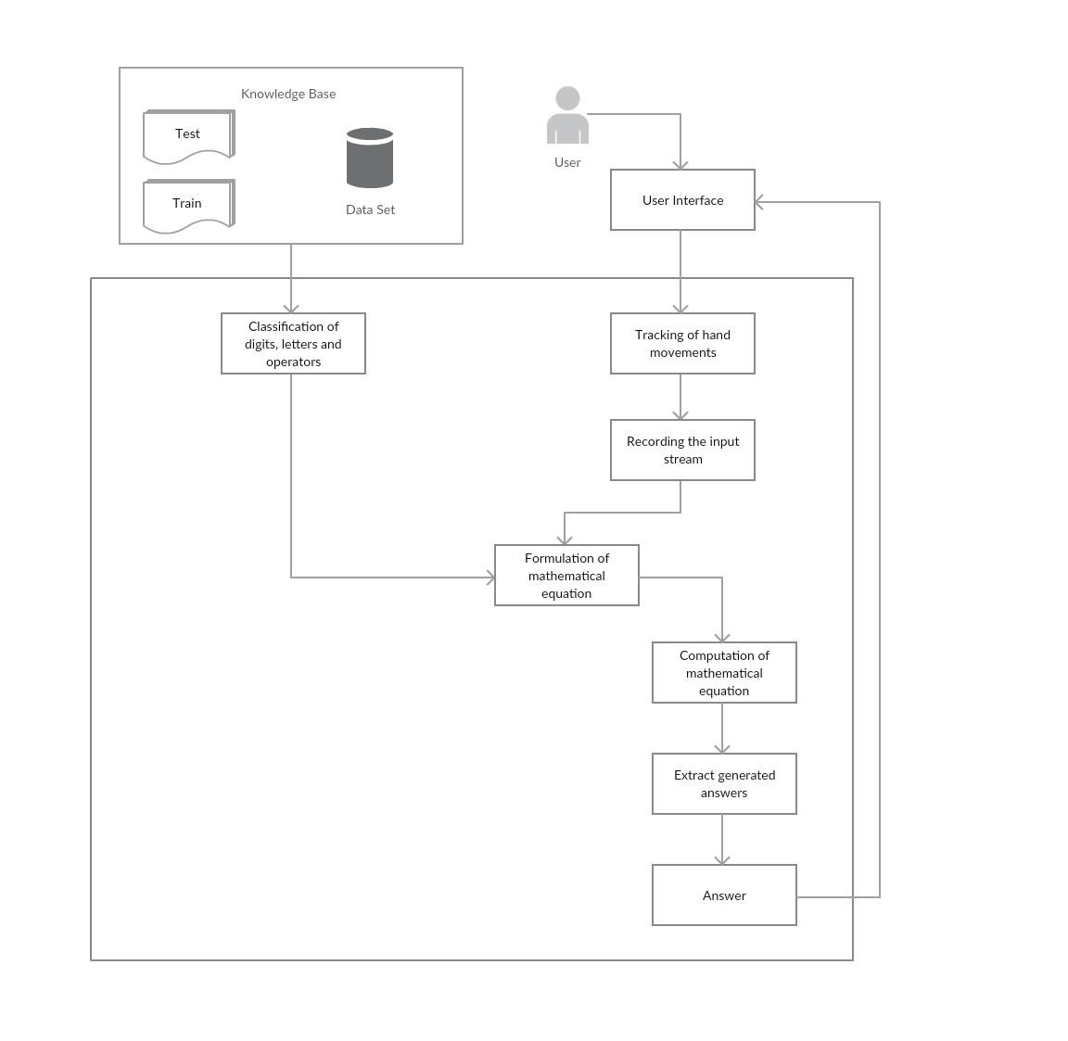
ARCHITECTURAL
DIAGRAM

Slide 24
UI Design

Slide 25
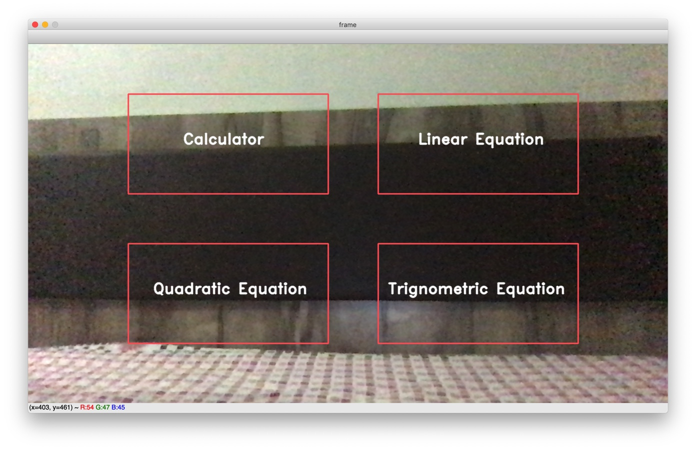

Slide 26
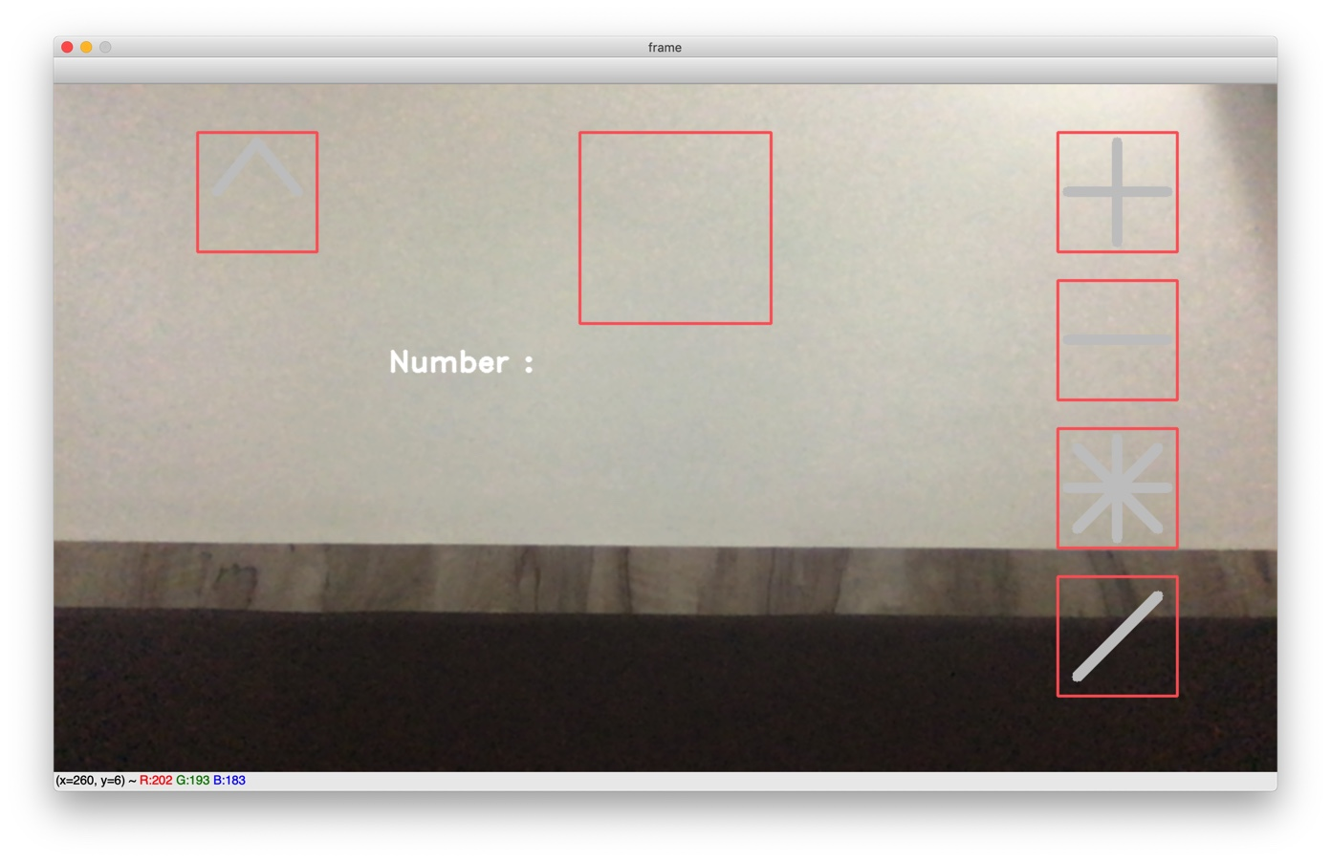

Slide 27
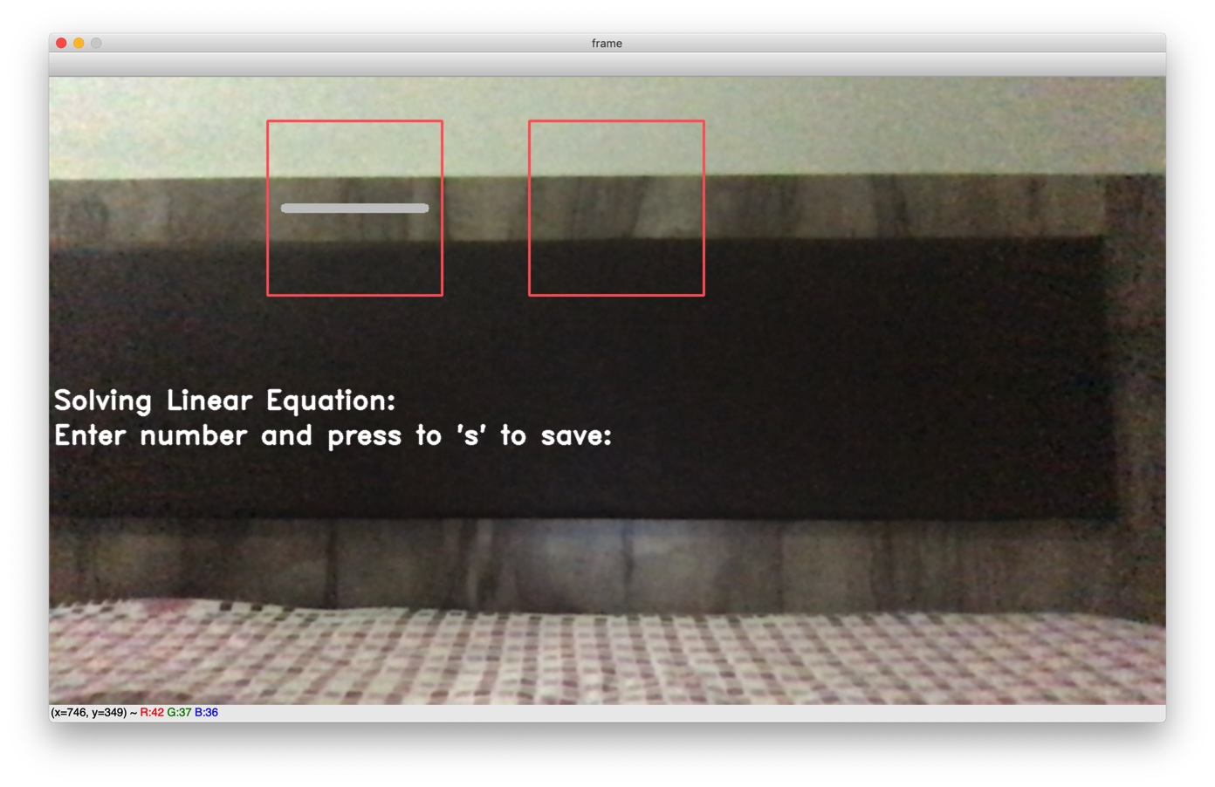

Slide 28
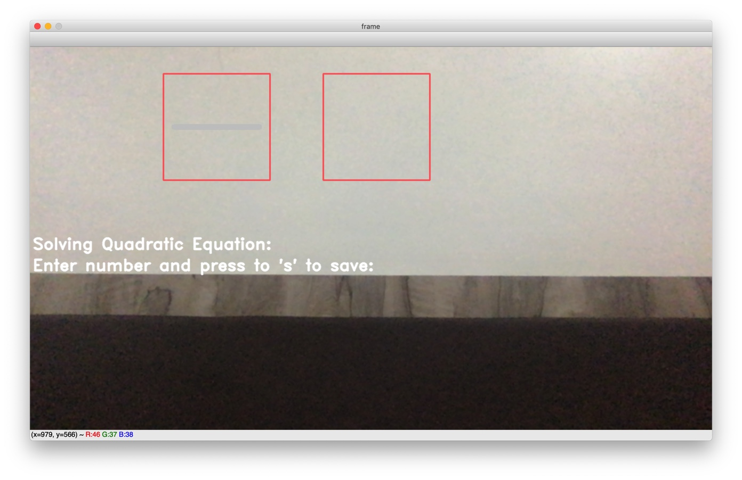

Slide 29
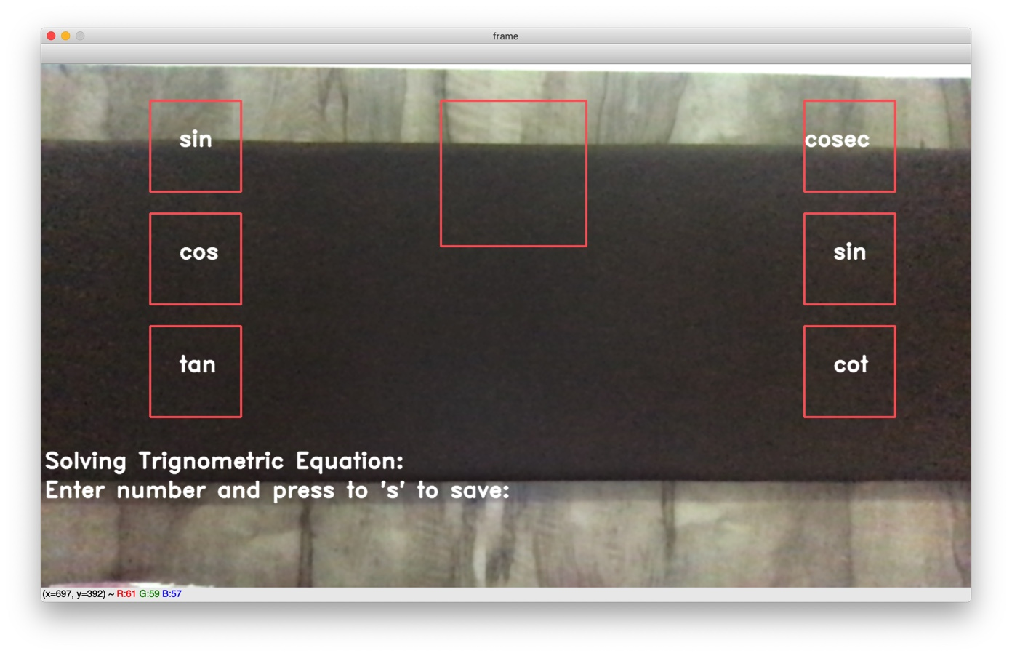

Slide 30
Chapter 6
Conclusion

Slide 31
CONCLUSION
Thus, an air writing system for computation of equations is developed using open computer vision for gesture recognition and neural networks for generating output of the equation.
The system extracts the path traced by the visual input and records it to be matched with the images stored in the database. The Convolutional Neural Network model is trained to recognize this input pattern and identify the numeral or operator and form a logical equation.
The objective of this project is to minimize the input complexity and provide an alternative to generate solution quickly. This system can be used for obtaining an optimal strategy with high efficiency.

Slide 32
Chapter 7
References

Slide 33
[1] 2016 International Conference on Emerging ELearning Technologies and Applications (ICETA). IEEE.
[2] K. Huang, L. Wang, T. Tan, and S. Maybank, "A real-time object detecting and tracking system for outdoor night surveillance," Pattern Recognition, vol. 41, no. 1, pp. 432-444, 2008.
[3] Burel, G., et al. “Recognition of Handwritten Digits by Image Processing and Neural Network.” [Proceedings 1992] IJCNN International Joint Conference on Neural Networks, doi:10.1109/ijcnn.1992.227098.
[4] J. Li, F. Li, and M. Zhang, "A Real-time Detecting and Tracking Method for Moving Objects Based on Color Video," in 2009 Sixth International Conference on Computer Graphics, Imaging and Visualization. IEEE, 2009, pp. 317-322.
[5] Poularakis, Stergios, and Ioannis Katsavounidis. “Low-Complexity Hand Gesture Recognition System for Continuous Streams of Digits and Letters.” IEEE Transactions on Cybernetics, vol. 46, no. 9, 2016, pp. 2094–2108., doi:10.1109/tcyb.2015.2464195.
[6] Burel, G., et al. “Recognition of Handwritten Digits by Image Processing and Neural Network.” [Proceedings 1992] IJCNN International Joint Conference on Neural Networks, doi:10.1109/ijcnn.1992.227098.

